Slide 1
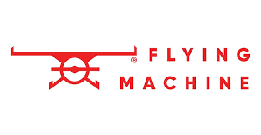
Comprehensive Digital Marketing Project Work
Brand :Flying Machine

Slide 2
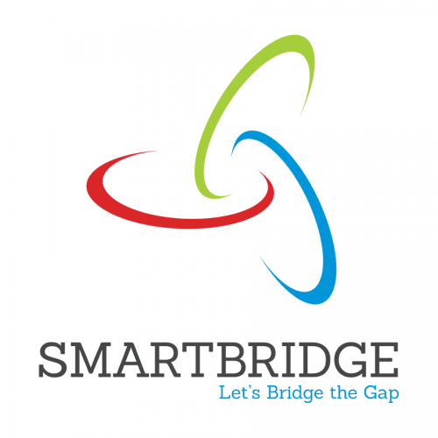
Project given by :

Slide 3
ACKNOWLEDGEMENT
The opportunity to participate in these internships has been an invaluable experience for my personal and professional development. I am extremely grateful to Dr. P L Madhava Rao sir for facilitating my placement with SMARTINTERZ and to Dr. P L Madhava Rao sir for providing me with guidance and mentorship throughout my time at Flying Machine Company.
Flying machine include all forms of aircarft studied or constructed before the developement of the modern aeroplane by 1910.The story of modern flight begins more than a century before the first successful manned aeroplane,and the earliest aircraft thousands of years before
I would also like to express my sincere appreciation to the college director, principal, and Head of the Department for providing me with the opportunity to undertake these internships as part of my academic curriculum. Your commitment to fostering practical learning experiences has greatly enriched my education.
I would also like to express my sincere appreciation to my team members for their unwavering support during my internship. Their encouragement, and willingness to share their expertise have been instrumental in my growth as a digital marketing professional.

Slide 4
TEAM MEMBERS
Team leader : Kuchipudi Sowmya Srivarshini
Team member : Kothuri Moulika
Team member : Kancharla Sivasai
Team member : Kuppala Pujitha
Team member : Maguluri Anilkumar

Slide 5
Brand study, Competitor Analysis & Buyer’s/Audience’s Personal
Flying Machine is an Indian denim and casual wear brand owned by Arvind Limited. It was launched in 1980 and has since become a prominent name in the Indian fashion industry. Here's a brief analysis of the Flying Machine clothes brand:
Market Positioning:Flying Machine is positioned as a youth-oriented brand that offers trendy and fashionable denim and casual wear. It's known for its edgy and contemporary designs, appealing to the younger demographic.

Slide 6
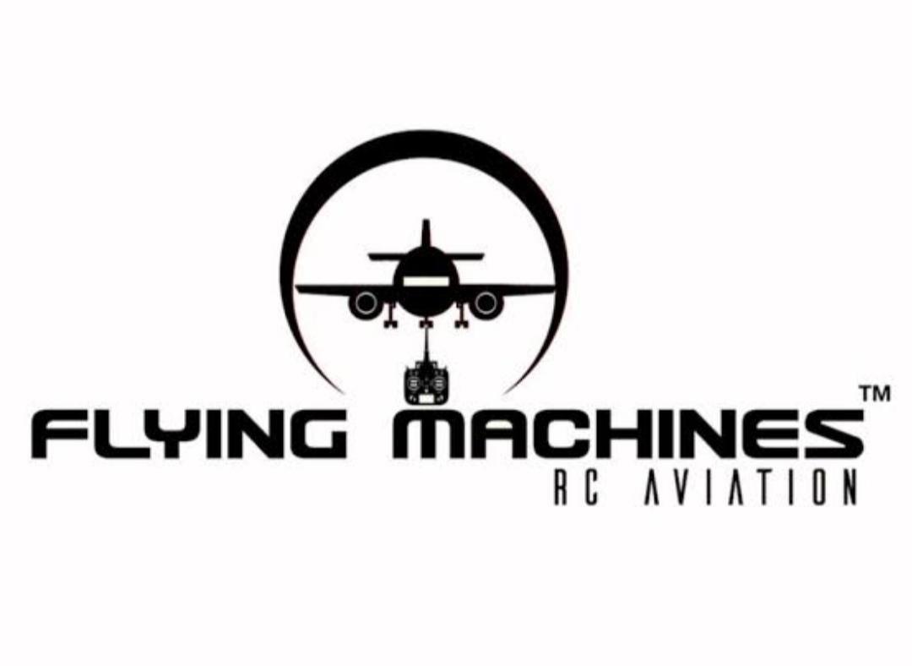
Analysis:
Target Audience: The brand primarily targets the urban youth and young adults who are fashion-conscious and value style and individuality.Its desings cater to those who want to make a statement with their clothing choices.
Product Range: Flying Machine offers a wide range of products including jeans, shirts, t-shirts, jackets, and accessories. Its focus on denim products has helped it carve a niche in the Indian fashion market.

Slide 7
History of Flying Machine:
Flying Machine is one of the indigenously grown brands started by garment division of Arvind mills. The brand was incepted in 80’s; On My 22,1906,the united states granted patent number 821,393 for a flying machine to wilber and orville wright.
It was an invetion that would change the world. for The brand had the positioning of ‘guaranteed brand’ due to its unique pricing and product innovation.
However, with the growing penetration of online retail and multiple retail channels, the brand started experiencing operational huddle in managing inventory as it goes on multiple channels.

Slide 8
Flying Machine India Company Profile
Company Full Name: Arvind Limited
Type: Private
Industry: Fashion wear
Founded Year: 1980
Founder: NA
Headquarters: Naroda, Ahmedabad, Gujarat, India
Key People: Mr. Sanjay Lalbha (CEO & MD)
Parent Company: Lalbhai Group
Subsidiaries: NA

Slide 9
SEO & Keyword Research
An SEO audit is a comprehensive evaluation of a website's search engine optimization (SEO) performance and overall health. The main purpose of an SEO audit is to identify areas of improvement and uncover issues that may be hindering the website's ability to rank well in search engine results. The SEO audit for lakme is as follows.
Keyword research helps you find which keywords are best to target and provides valuable insight into the queries that your target audience is actually searching on it.
In bound methodology,we dont create content around what we want to tell people;we should be creating content around what people want to discover.In other words,our auidence is coming to us.

Slide 10
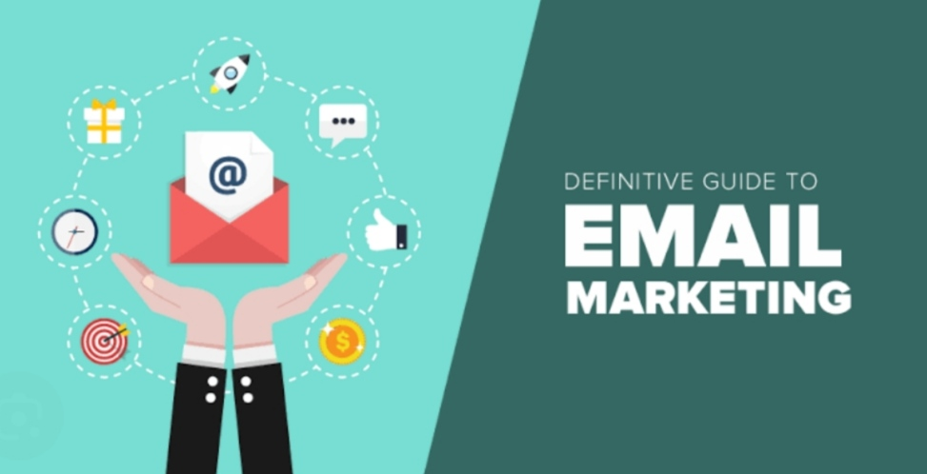
EMAIL MARKETING
Flying Machine Head Office Email ID: care@nnnow.com
Retail brands like fashion stores have an industry average open rate of 18.39% and an average click rate of 2.25% for their marketing emails, according to Mailchimp.
There’s a reason the average return on investment for email marketing is still $42 for every dollar. It’s simple yet so effective. In total, email marketing is responsible for 81% of customer acquisition and 80% of customer retention.

Slide 11
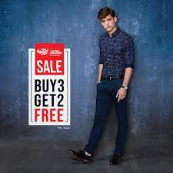
SOCIAL MEDIA MARKETING
Influencer marketing budgets are increasing year-over-year, with 17 percent of companies planning to spend more than half of their budget on this marketing method. There are several ways you can work with influencers to increase sales and spread brand awareness.
FACEBOOK
Facebook is the most used social media platform in the world with 2.45 billion monthly active users. In addition to regular Facebook posts, fashion app marketers can use the platform for live broadcasts. For example, ASOS went live with ‘100 layers of ASOS,’ a short contest between ASOS staff members where they had 30 minutes to create a look for their models – using 100 layers for ASOS clothing dramatic effect.

Slide 12
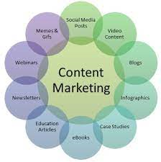
CONTENT MARKETING
Content marketing is an essential strategy that allows businesses to reach, engage and connect with clients through unique content.
This generally involves creating exciting and unique content in the form of blog posts, videos and infographics. The goal is to use keywords that appeal to or stick to the client’s memory, thus motivating them to consider your product or service.

Slide 13
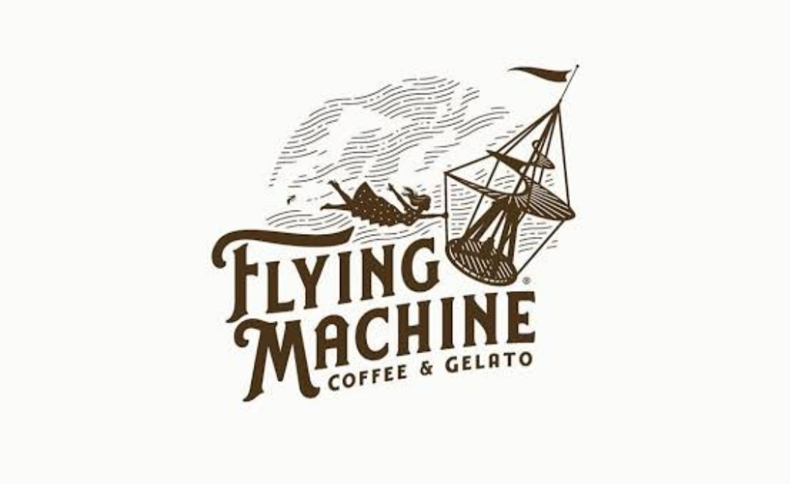
INSTAGRAM
Instagram has an active global audience of 500 million daily active users,collectively tapping the platforms “LIKE” button 4.2 billion times every day.
Instagram offers several ways to connect with your audience,including posts,reels,stories,highlights and IGTV.Instagram is synonymous with social media fashion influencers and 69 percent of marketers paln to spend more money on Instagram influencers than any other market this year.
Link:https://Instagram.com/flyingmachine80?igshid=MmU2YjMzNjRIOQ==

Slide 14
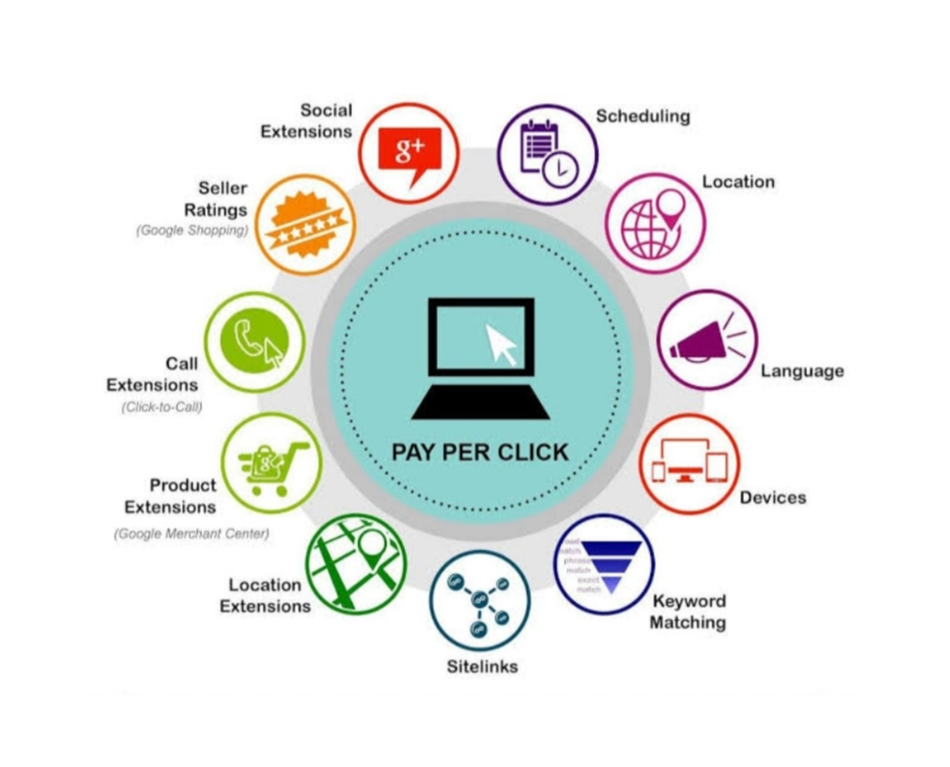
PAY FOR CLICK ADVERTISING
Pay per click advertising is a very effective digital marketing strategy. It involves paid advertisement wherein the business pays for specific keywords such that when a person searches using those keywords, the particular business site appears.

Slide 15


